Slide 1

EE-371 : Control Systems
Lecture#30
ROOT LOCUS TECHNIQUES (A Graphical Tool)
8.5 Refining the Sketch of Root Locus
Textbook: Chapter # 08 (5th edition)
Text Book: Control Systems Engineering by Norman S. Nise 5th Edition
Instructor: Ms Neelma Naz
Class: BEE 12 C/D
School of Electrical Engineering and Computer Science
Department of Electrical Engineering

Slide 2
Rules for Sketching the Root Locus
1. Number of branches.
The number of branches of the root locus equals the number of closed-loop poles
2. Symmetry.
The root locus is symmetrical about the real axis.

Slide 3
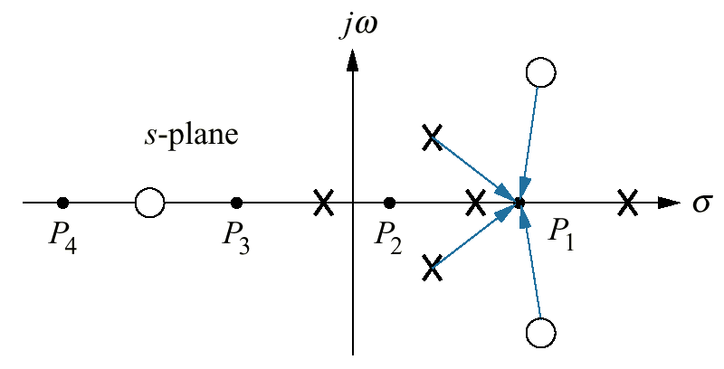

Rules for Sketching the Root Locus
3. Real-axis segments.
On the real axis, for K > O the root locus exists to the left of an odd number finite open-loop poles and/or finite open-loop zeros.
Angle criterion

Slide 4
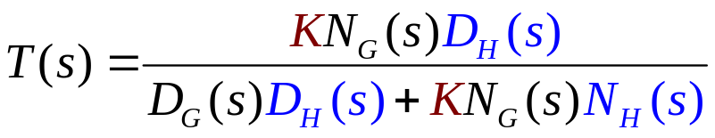
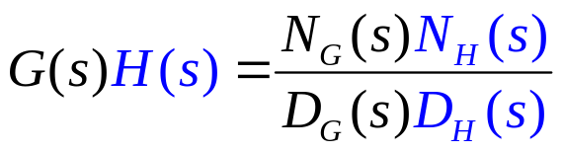
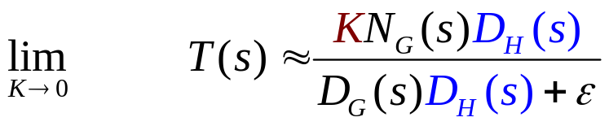
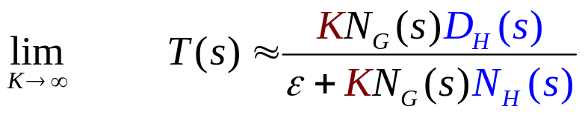
Rules for Sketching the Root Locus
4. Starting and ending points.
The root locus begins at the finite and infinite poles of G(s)H(s) and ends at the finite and infinite zeros of G(s)H(s).
Closed-loop system poles at small gains approach the combined poles of G(s) and H(s)
Closed-loop system poles at large gains approach the combined zeros of G(s) and H(s)

Slide 5
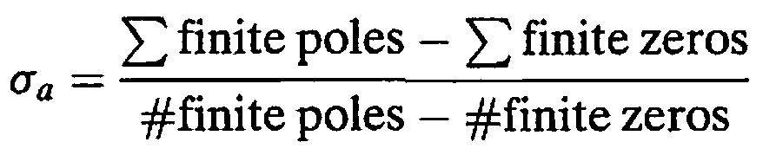
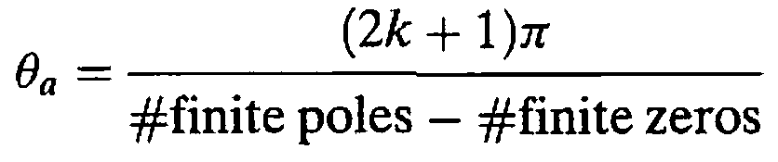
Rules for Sketching the Root Locus
5. Behavior at infinity.
The root locus approaches straight lines as asymptotes as the locus approaches infinity.
The equation of the asymptotes is given by the real-axis intercept σ_{a,} and angle θ_{a} as follows:
where k = 0, ±1 , ±2, ±3 and the angle is given in radians with respect to the positive extension of the real axis.

Slide 6
If the function approaches infinity as s approaches infinity, then the function has a pole at infinity.
G(s) = s has a pole at infinity
If the function approaches zero as s approaches infinity, then the function has a zero at infinity
G(s) = 1/s has a zero at infinity
Every function of s has an equal number of poles and zeros if the finite and infinite poles and zeros are included

Slide 7
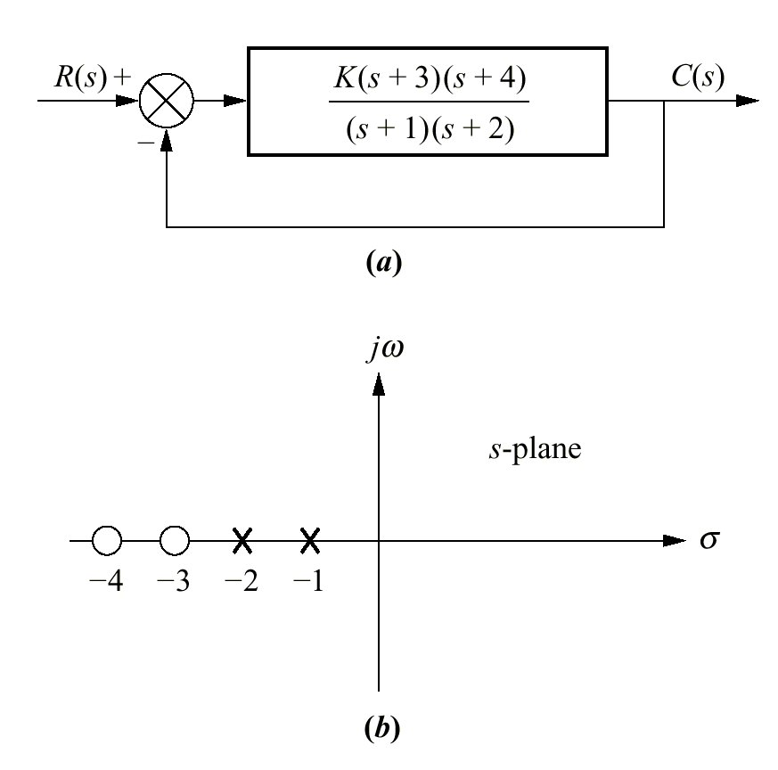
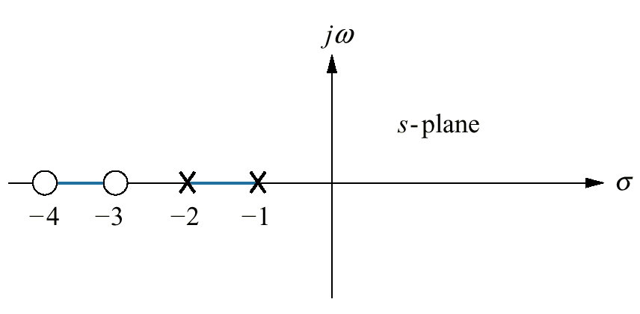
Real-axis segments of the root locus for the
system shown in the figure

Slide 8
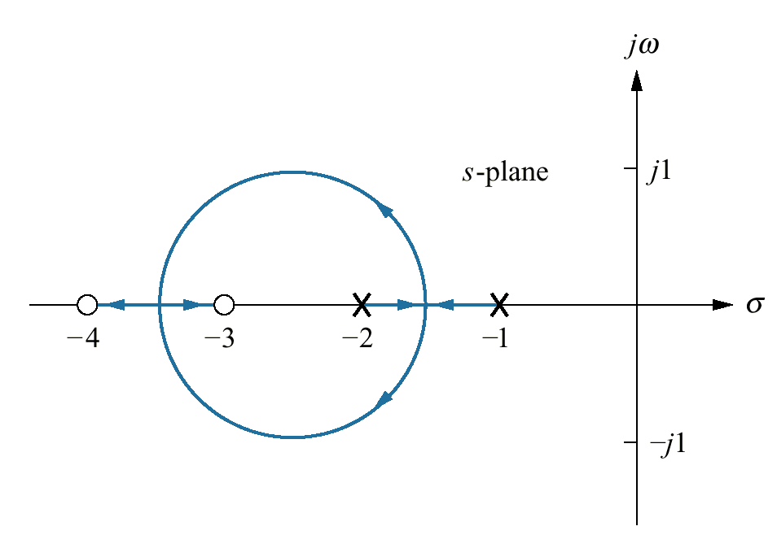
Complete root locus for the system

Slide 9
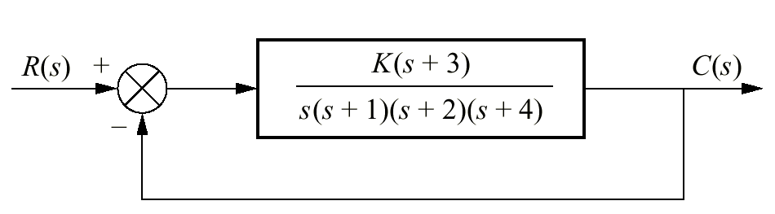
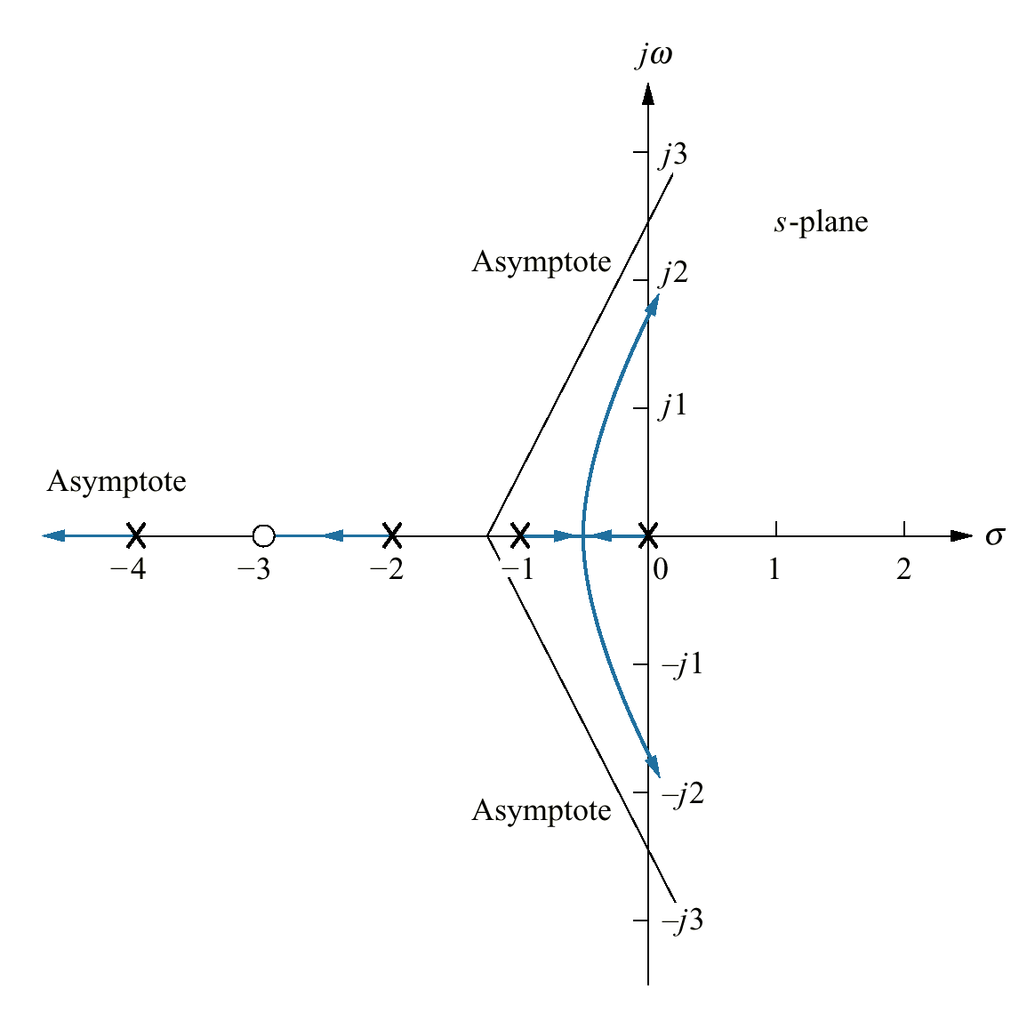
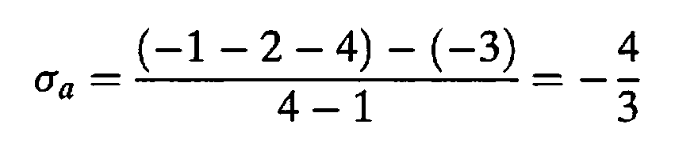
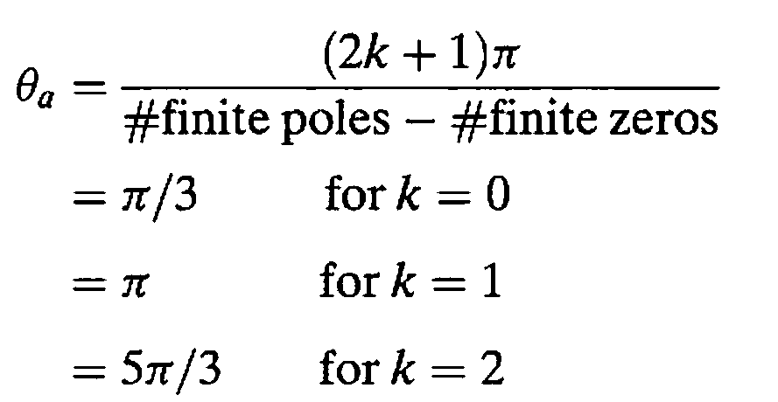
Example 8.2
PROBLEM: Sketch the root locus for the system shown in the Figure.

Slide 10
Example 8.2
PROBLEM: Sketch the root locus for the system shown in the Figure.

Slide 11
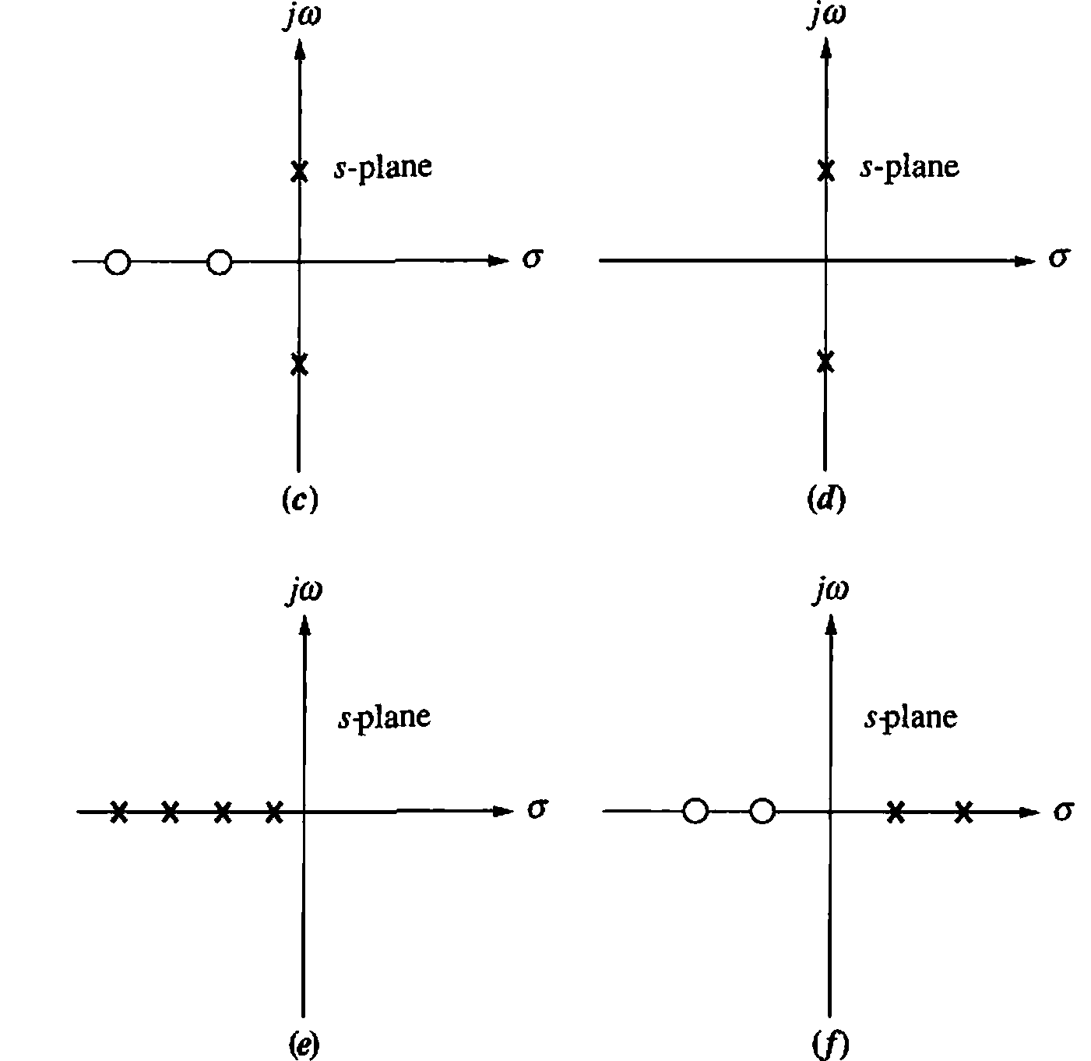
Sketch Root Locus

Slide 12
Refining the Sketch of Root Locus

Slide 13
Breakaway and Break-in points:
Points on the real axis where the root locus leaves or enters the real-axis
jω-axis Crossing:
Points where the root locus cross the jω-axis
Angles of departure and arrival:
The angles of departure from complex poles and angles of arrival at complex zeros

Slide 14
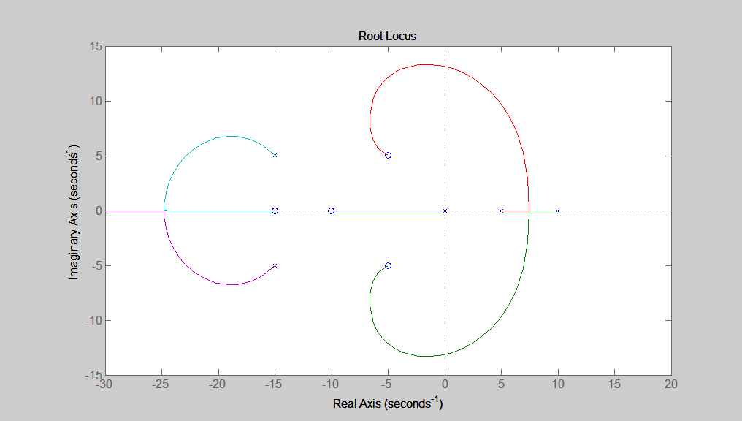
Angles of departure:
The angles of departure from complex poles
Breakaway points:
Points on the real axis where the root locus leaves the real-axis
Angles of arrival:
The angles of arrival at complex zeros
Break-in points:
Points on the real axis where the root locus enters the real-axis
jω-axis Crossing:
Points where the root locus cross the jω-axis

Slide 15
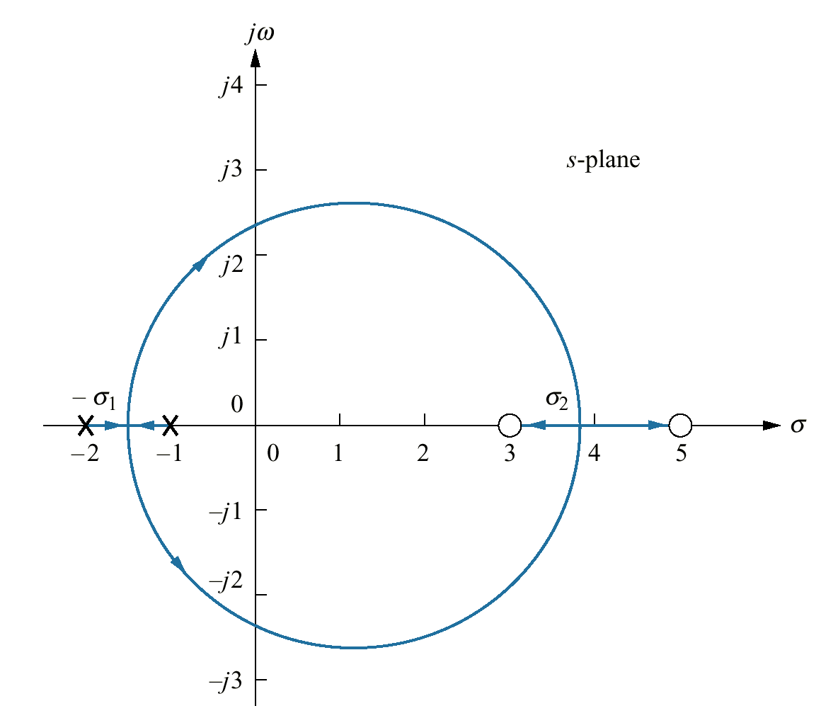
Breakaway and Break-in points:
Real- axis breakaway (-σ₁) and break-in points (σ₂)
The root locus is sketched using the first four rules:
(1) number of branches
(2) symmetry
(3) real-axis segments
(4) starting and ending points
The branches of the root locus form an angle of 180° /n with the real axis.
“n” is the number of closed-loop poles arriving at or departing from the single breakaway or break-in point on the real axis

Slide 16
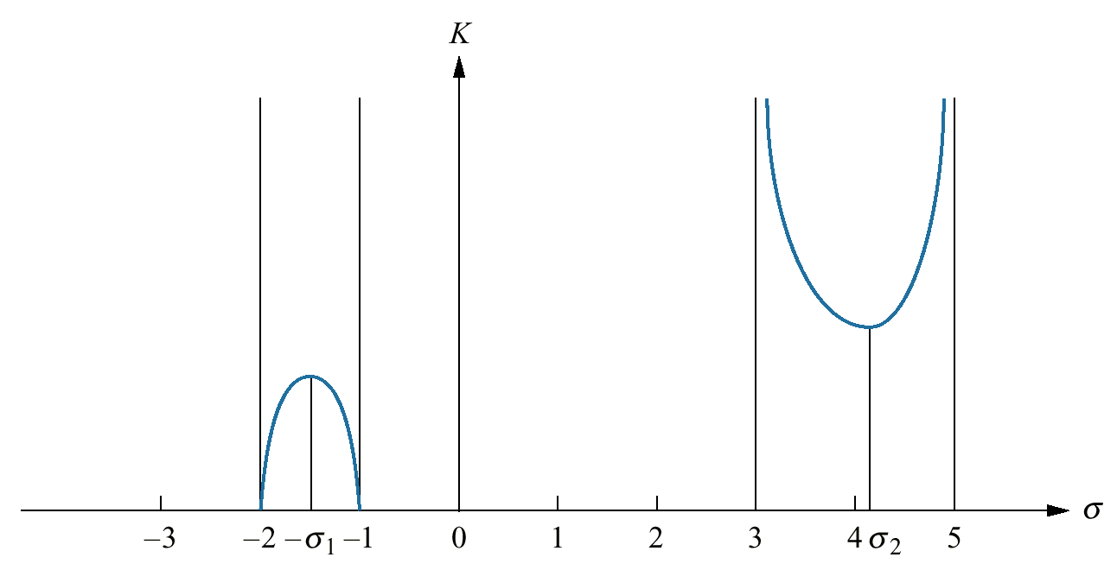
Breakaway and Break-in points:
Variation of gain along the real axis of the root locus
The breakaway point occurs at a point of maximum gain on the real axis between the open-loop poles
The gain at the break-in point is the minimum along the real axis between the two zeros

Slide 17

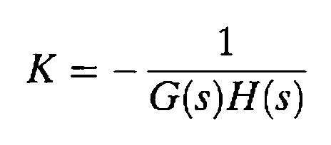
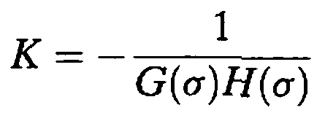
Considering the values of s on the real axis only ( i.e. s = σ )
How do we find maximum and minimum
???

Slide 18
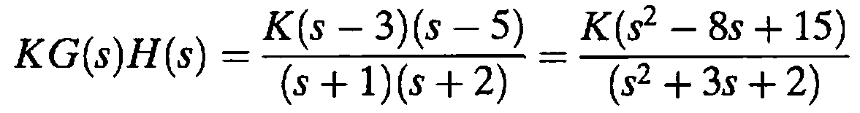
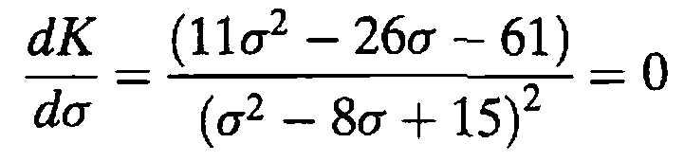
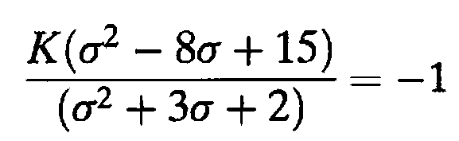
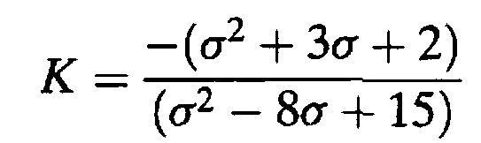
Example 8.3
Breakaway and Break-in Points via Differentiation
PROBLEM: Find the breakaway and break-in points for the root locus depicted in the Figure, using differential calculus.
SOLUTION:
Using the open-loop poles and zeros, the open-loop system is represented as:
For all points along the root locus, KG(s)H(s) = -1, and along the real axis, s = σ.
therefore
σ= -1.45, 3.8

Slide 19
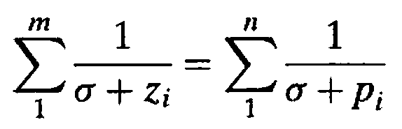
transition method
Breakaway and break-in points satisfy the relationship
where z_{i} and p_{i} are the negative of the zero and pole values, respectively, of G(s)H(s)

Slide 20
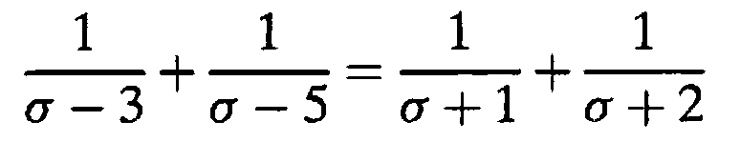
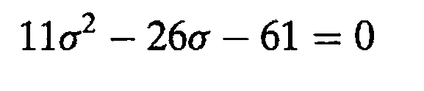

Example 8.3
Breakaway and Break-in Points via Differentiation
PROBLEM: Find the breakaway and break-in points for the root locus depicted in the Figure, using differential calculus.

Slide 21
jω-axis Crossing
The jω-axis crossing separates the stable operation of the system from the unstable operation
The system's poles are in the left half-plane up to certain value of gain
Using Routh-Hurwitz criterion to find jω-axis crossing points

Slide 22


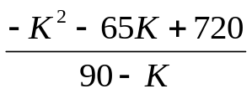
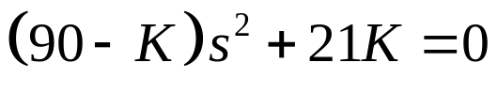



Example 8.5
For the system shown in the Figure, find the frequency and gain, K, for which the root locus crosses the imaginary axis. For what range of K is the system stable?
SOLUTION:
The closed-loop transfer function
s⁴
s³
s²
s¹
s⁰
1 | 14 | 3k
7 | 8+K | 0
{row s¹ zeros
K = 9.65, -74.65
90 - K | 21K | 0
 | 0 | 0
21K | 0 | 0
The RL is plotted only for +ve values of gain, thus K = 9.65
{aux polynomial
Range of stability of K
Jω-axis xing

Slide 23
j1.6
K=9.65
-j1.6
K=9.65

Slide 24
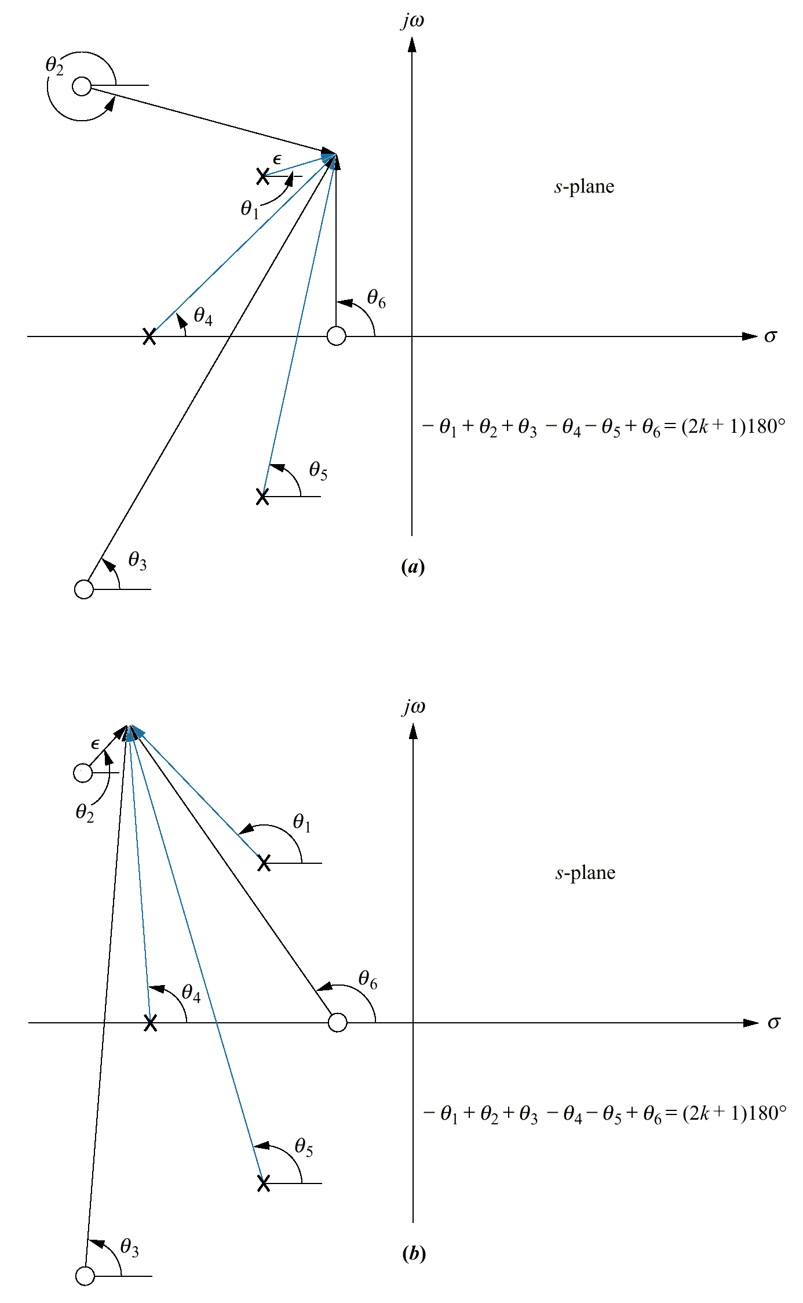
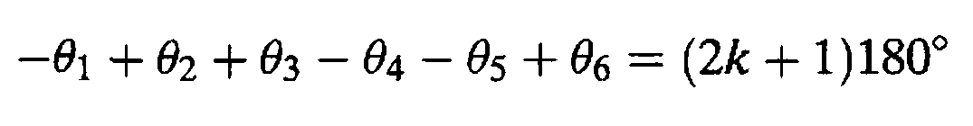
Angles of Departure and Arrival
Assume a point on the root locus ε close to a complex pole, the sum of angles drawn from all finite poles and zeros to this point is an odd multiple of 180°.
Except for the pole that is ε close to the point, assume vectors from all other poles and zeros are drawn directly to the pole that is near the point.
The only unknown angle is the angle θ₁ drawn from the pole close to the point.

Slide 25
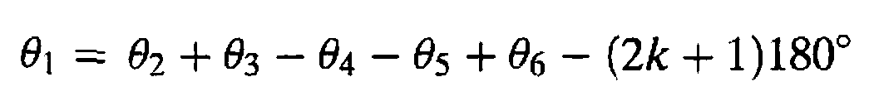
angle of departure

Slide 26
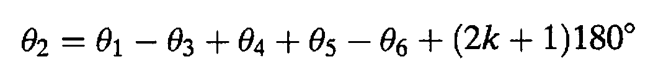
angle of arrival

Slide 27

???

